Slide 1
Urgent and emergency care
HWE needs analysis
Dr Rachel McCarthy, Public Health Registrar
Delyth Forth, Senior Head of PHM Delivery
Jaron Inward, Senior PHM & Intelligence Champion Manager
Dr Holly Jenkins, Associate Medical Director

Slide 2
Acknowledgements
Author: Dr Rachael McCarthy, Specialty Registrar in Public Health East of England, HWE ICB
Dr Rachel Joyce, Medical Director HWE ICB
Dr Sam Williamson, Assistant Medical Director HWE ICB
Charlotte Mullins, Population Health Management HWE ICB
Delyth Ford, Population Health Management HWE ICB
Rushabh Shah, Data Analyst HWE ICB
Elizabeth Disney, Director of Operations HWE ICB
Phillip Lumbard, Assistant Director East & North – Urgent Care HWE ICB
Ian Armitage, Programme Director – UEC & System Resilience, S&W Herts Place, HWE ICB
Michelle Bullman, Assistant Director of System Resilience (Interim), West Essex, HWE ICB
Dr Elizabeth Kendrick, UEC clinical lead HWE ICB and Medical Director HCT
Dr Vipul Parbat, UEC clinical lead HWE ICB
Dr Vishen Ramkisson, UEC clinical lead HWE ICB
Dr Rachel Hoey, UEC clinical lead HWE ICB
Aurelie Frantschi, Business Intelligence PHM & Transformation Lead HWE ICB
Carl Bates, Business Intelligence HWE ICB
Jaron Inward, Senior PHM & Intelligence Champion Manager
Chris Langley, Senior Information Analyst HWE ICB
Christine Chaffin, Frailty Programme Manager HWE ICB
Anna Benson, Mental Health Lead HWE ICB
Dr Heidi Bowring, Clinical Fellow HWE ICB
Dr Jasjot Saund, Clinical Fellow HWE ICB
Dr Khyati Patel, Clinical Fellow HWE ICB
Paul O’Hare, Programme Manager – Urgent Care HWE ICB
All members of the HWE ICB UEC board who attended meetings, seminars and provided feedback and questions.
Colleagues at Hertfordshire County Council and Essex County Council

Slide 3
Contents
Definition of urgent and emergency care
Aims and purpose
Key demographics of HWE
UEC activity in HWE – A&E attendances
  Rates of A&E attendance
  Where do our population attend A&E?
  A&E attendance by demographics
  A&E attendances by population segment
  Who is at risk?
5. UEC activity in HWE – emergency hospital admissions
  Rates of emergency hospital admission
  Emergency hospital admissions by population segment
  High intensity users
  Ambulatory care sensitive conditions by segmentation
6. Summary of UEC need across the life course
7. Triangulation
Mental health clinical deep dive
Missed opportunities audit
Current service provision
Service user perspectives
Evidence review
8. Summary and recommendations
9. Opportunities to inform UEC strategy

Slide 4
Introduction
What are urgent and emergency care services?
Urgent and emergency care (UEC) services (listed in the table) perform a critical role in keeping people healthy. Other UEC services include: GP in-hours appointments, Same Day Emergency Care (SDEC) and a range of community services (e.g. Urgent Community Response, UCR).
Challenging context for UEC
UEC services across the country are operating in challenged capacity, higher demand, and an ageing population with increasingly complex health needs.
The NHS Long Term Plan (2019) outlined an ambitious commitment to continue transformation of urgent and emergency care services to ensure patients get the right care, in the right place, whenever they need it.
Emergency | Life threatening illnesses or accidents which require immediate, intensive treatment. Services that should be accessed in an emergency include ambulance (via 999) and emergency departments.
Urgent | An illness or injury that requires urgent attention but is not a life-threatening situation. Urgent care services include a phone consultation through the NHS111 Clinical Assessment Service, pharmacy advice, out-of-hours GP appointments, and/or referral to an urgent treatment centre (UTC). If unsure what service is needed, NHS111 can help to assess and direct to the appropriate service/s.
Source: NHS website

Slide 5
Aims and purpose
The urgent and emergency care (UEC) analysis has been developed for Hertfordshire and West Essex (HWE) Integrated Care Board (ICB).
Purpose: to inform the HWE Integrated Care System (ICS) urgent and emergency care strategy
Aim: to understand the urgent and emergency care needs of the population of Hertfordshire and West Essex
Objectives:
  To build a comprehensive picture of who needs to access UEC in HWE, and who could be better cared for in alternative settings
  To understand why people are accessing UEC and identify opportunities for different services and alternative pathways
  To use epidemiological approaches with triangulation of multiple data sources and stakeholder consultation to build consensus in defining the key UEC issues in HWE
  To inform a successful UEC strategy that is underpinned by population need
Scope: this work does not attempt to replicate performance reports, instead the focus is on people and their pathways, informed by outcomes and the segmentation model.

Slide 6
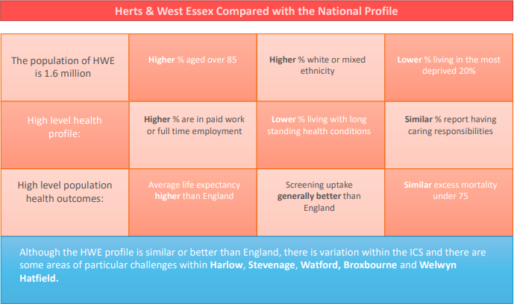
Key demographics for Hertfordshire and West Essex ICS
Compared to the national demographic profile, the population in HWE is relatively affluent. However, some communities struggle with deprivation and poverty, and poorer health outcomes, particularly Broxbourne, Harlow, Stevenage, Watford and Welwyn Hatfield.
There is also a higher proportion of the population over 85 years old compared to national average.
Source: Health Needs Analysis Overview August 2022, ICB Population Health Management team

Slide 7
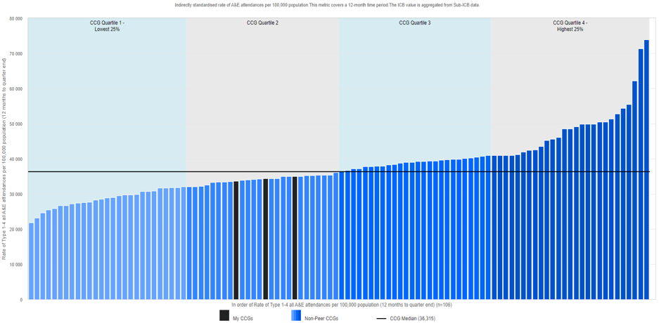
UEC activity in HWE: A&E attendances
Rate of Type 1-4* (all) A&E attendances per 100,000 population Q3 2022 to Q3 2023, national distribution
The rate of A&E attendances amongst the population of Hertfordshire and West Essex is lower than national median (quartile 2). Rates are similar across all three Places – East & North Hertfordshire (ENH), South & West Hertfordshire (SWH), and West Essex (WE).
SWH
33,659
ENH
34,410
WE
35,009
Type 1 A&E dept is consultant-led 24-hour with full resuscitation facilities, Type 3 is Urgent Treatment Centre, Minor Injury Units, Walk-in Centres, Urgent Care Centre
Source: Model Hospital

Slide 8
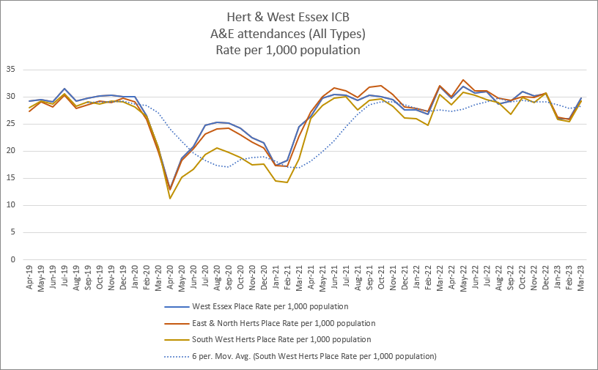
UEC activity in HWE: A&E attendance rates per 1,000 population over time
Nationally, A&E attendances have risen over time, 12.1% increase between 2012/13 and 2021/22. With the exception of a dip in rates during Covid-19 lockdowns, the rate of A&E attendances has recovered and continues to rise in HWE and nationally.
All three places across the ICS have followed a similar pattern in rates.
With this increasing demand, it has been harder to achieve A&E performance targets. In 2022/23:
64.75% of attendances spending 4 hours or less (compared to national 70.7%)
Time from arrival to initial assessment (ambulance only) longer in PAH compared to national
Longer times to treatment across all three trusts
Source: NHS Digital A&E Quality indicators
Rate of A&E attendances (all types) in HWE population, per 1,000 population, Apr 2019 – Mar 2023
Source: SUS

Slide 9

UEC activity in HWE: Demographics
A&E attendances in 2021/22 in HWE
Children 0-18
Adults 19-64
Older People 65+
In 2021/22 there were over half a million A&E attendances amongst HWE population.
Patients aged under 35 years accounted for 47.7% of all attendances (similar to proportion nationally, 47.1%)
1 in 5 people in HWE attend A&E every year, this is broadly similar across all three places, but slightly higher (1 in 4) in West Essex.
Approximately a third of attendances are low acuity and resulted in no investigation or treatment, and are potentially avoidable.
25% of our unplanned activity takes place outside the ICS footprint
554,007 A&E Attendances in 2021/22
Children = 149,161 (26.9%)
Adults = 282,232 (50.9%)
Older People = 122,614 (22.1%)
339,677 people attended A&E in 2021/22
Children = 93,099 (27.4%)
Adults = 178,337 (52.5%)
Older People = 68,882 (20.3%)
171,929 (31%) of attendances resulted in no investigation and no treatment
(includes Uncoded Activity)
Children = 60,365 (40.5%)
Adults = 89,519 (31.7%)
Older People = 22,045 (18%)
This translates to 1 in 5 people registered with ICB attending A&E
Children = 1 in 4 children
Adults = 1 in 5 adults
Older People = 1 in 4 older people
Source: SUS

Slide 10
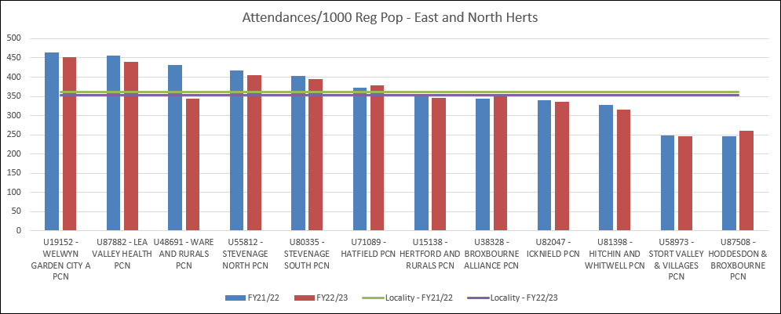
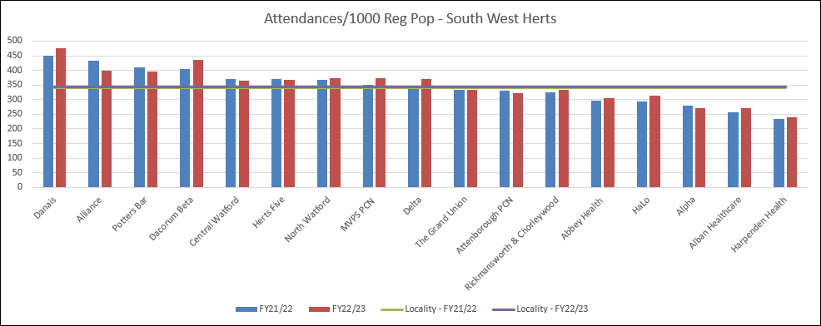
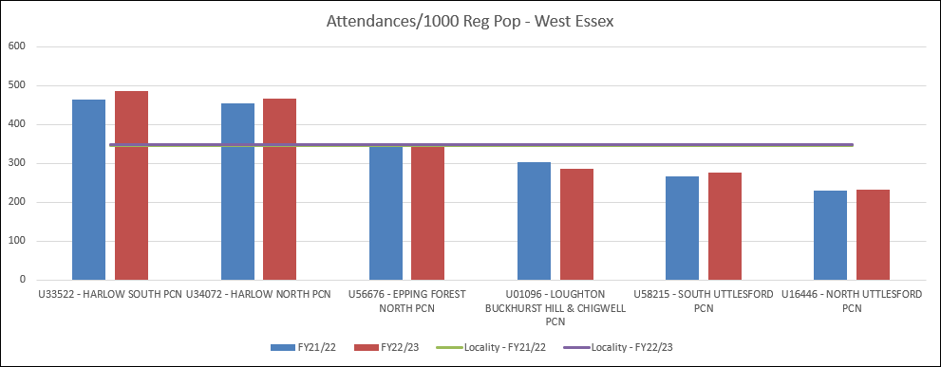
UEC activity in HWE: by PCN
The graphs show the variation in A&E attendances (all types) per 1000 registered population across PCNs for each locality for 2021/22 and 2022/23.

Slide 11
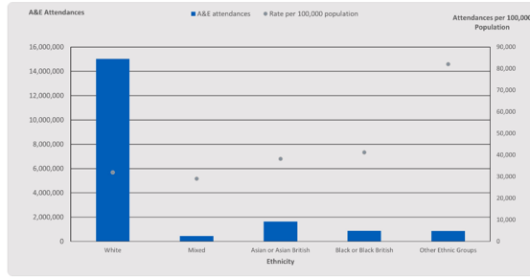
UEC activity in HWE: Demographics
The rate of A&E attendances varies by localities. Factors affecting this variation include:
  Proximity to services - higher rates in areas in close proximity to acute hospital trusts such as Harlow and Stevenage.
  Deprivation – nationally, the rates of A&E attendances per head of population for people living in the most deprived areas is nearly double that of those in the least deprived. This is replicated locally.
  Ethnicity - nationally, the rates of A&E attendances in 2021/22 were lowest in people with a mixed ethnic background and highest in people from other ethnic groups.
A&E attendances by ethnicity and rate per 100,000 population (2021/22)
Source: ECDS and ONS Summary Reports - IMD and Ethnicity - NDRS (digital.nhs.uk)

Slide 12
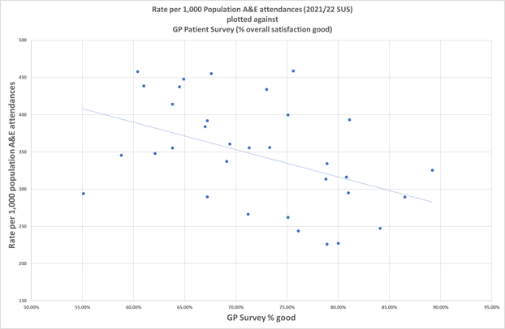
Patient satisfaction and A&E attendances
Relationship between patient satisfaction with GP practice and A&E attendance rate, HWE 2021/22
Other factors that may contribute to the variation in A&E attendance include patient satisfaction with GP practice.
Nationally, an inverse correlation between average number of A&E attendances per 1,000 population and average patient satisfaction with their practice and the access they have to it has been found (Source: Health and Social Care Information Centre). This is reflected in our local data shown in the chart.
This does not infer causation as other factors influence this relationship such as deprivation.
We know there is significant variation in patient experience between GP practices.
Notes:
RM

Slide 13
Assessing urgent and emergency care needs across different segments
The HWE population health management team developed a model that segments the population into groups of individuals with similar needs to help us to understand how different services can be provided for different groups of the population.
The model uses linked data (collected 1 Jan 2021 to 31 Dec 2021) from primary care, secondary care, community care and mental health services, covering approximately 80% of the HWE population.
There are five segments within the model and 17 subsegments. The segmentation model considers physical and mental health aspects as well as social factors when allocating people to segments. The segments range from those who are generally healthy and have no known health conditions, to the frailest patients and those at the end of life.
This model has been overlaid onto UEC activity data to understand how best to meet the UEC needs of different groups of people and what alternative pathways of care or services can be provided.
"Generally healthy"
Living with Illness
Lower Complexity
End of Life, Frailty & Dementia
Advanced Disease & Complexity
Notes:
CM

Slide 14
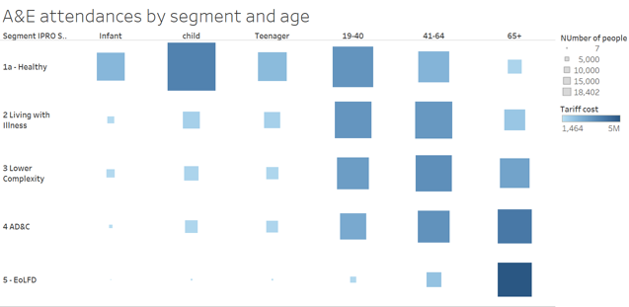
Segmentation model: A&E attendances (all)
Overlaid the segmentation model to allow analysis of A&E activity by segment and other factors such as age.
Size of the box represents volume of activity and depth of colour represents total cost.
The highest volume of A&E attendances were amongst children in the healthy segment, and to a lesser extent younger adults in this segment.
Substantial activity in the adult population in segments ‘living with illness’ and ‘lower complexity’, highlights the potential for improved early identification and proactive management in the community.
The highest cost A&E attendances are amongst older adults 65+ in segment ‘End of Life, Frailty and Dementia (EoLFD)’. The high cost is likely a result of the acuity of presentations. There is an opportunity to reduce this demand through advanced care planning, alternatives to conveyance and offering care closer to home (urgent community response and virtual wards).
Source: SUS overlaid with segmentation model

Slide 15
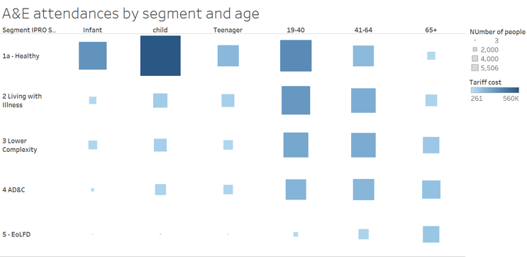
Segmentation model: A&E attendances (low acuity)
General Practice
Mental health crisis
Dental
Low acuity A&E activity includes those A&E attendances coded with healthcare resource group (HRG) codes VB11z which means they had no investigation and no significant treatment.
When looking at low acuity (VB11z) A&E attendances only, the greatest volume of these were amongst healthy children, and this volume is driving the high costs.
Optometry
Same Day Access
Acute- e.g UTC
Pharmacy
Community
Care –e.g rapid response/ virtual ward
111
Self referral – e.g IAPT
These urgent care needs could be better addressed by alternative pathways such as primary care same day access, minor illness hub, and community pharmacy services.
There is also an opportunity to use other services such as health visiting and education (e.g. Healthier Together website).
Notes:
Selecting VB11z only (no investigation with no treatment) highlights the children within the healthy segment accessing A&E

Slide 16
A&E attendances – most frequent presentations
Segment | Infant | Child | Teenager | 19-40 | 41-64 | 65+
Healthy | Fever Difficulty breathing Vomiting Head injury Rash | Upper limb injury Fever Lower limb injury Head injury | Upper limb injury Lower limb injury Abdo pain | Lower limb injury Upper limb injury Abdo pain Chest pain | Lower limb injury Upper limb injury Chest pain Abdo pain | Upper limb injury Lower limb injury Chest pain
Living with illness | Fever Difficulty breathing Dyspnoea Head injury | Upper limb injury Fever Lower limb injury Difficulty breathing | Upper limb injury Lower limb injury Abdo pain Feeling depressed | Abdo pain Lower limb injury Chest pain | Chest pain Lower limb injury Abdo pain | Chest pain Upper limb injury Lower limb injury Abdo pain Weakness
Lower complexity
AD&C | Fever Difficulty breathing Dyspnoea Vomiting | Upper limb injury Fever Lower limb injury Abdo pain | Upper limb injury Lower limb injury Abdo pain | Abdo pain Chest pain Lower limb injury Substance misuse | Chest pain Abdo pain Lower limb injury | Weakness Dyspnoea Chest pain Unsteady gait
EoLFD
The most frequent presentations at A&E by population segment across the life course are listed. Of note:
One third (30.4%) of healthy infants attend A&E with a fever.
In teenagers in population segments living with illness and lower complexity, in addition to acute injury and illness presentations that expect, 2.2% of presentations were coded as feeling depressed.
Amongst young adults (19-40 years) in the advanced disease and complexity segment, substance misuse accounted for 3.2% of A&E attendances. This segment accounts for not just physical and mental health complexity, but also social factors.
Older adults (65+) in EoLFD many of the most frequent presentations reflect frailty crises (weakness 14.4%, unsteady gait (11.7%).
Source: SUS data Jan 2021-July 2022 overlaid with segmentation model
Notes:
From segmentation overlay of SUS, determined most frequent presentations (listed most frequent at the top)

Slide 17
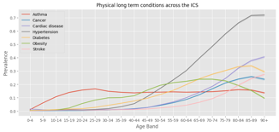
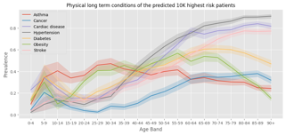
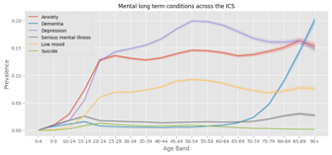
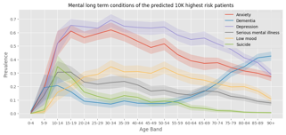
Who is at risk of attending A&E
To determine patients at high risk of attending A&E a machine learning model was applied to the segmentation dataset (1.25 million) and input features including demographic, diagnosis codes, prescribed medications, waitlist information, and environmental data (housing and proximity to healthcare) were ranked to identify the 30 most significant features that explained variance in requiring A&E or not.
Secondary machine learning models were then used to classify patients based on these significant features. Substance misuse, distance to GPs and pharmacies, and prescribed medication were among the most significant predictive factors of A&E attendance.
These predicted risk scores are used to estimate and describe the highest-risk (1.8%) cohorts of patients.
Credit: Rushabh Shah
Certain features were more prevalent in cohorts identified as high risk of A&E attendance compared to general ICS population include:
  cardiac disease and stroke for all ages
  mental long-term conditions, particularly suicide and serious mental illness in teenagers/young adults

Slide 18
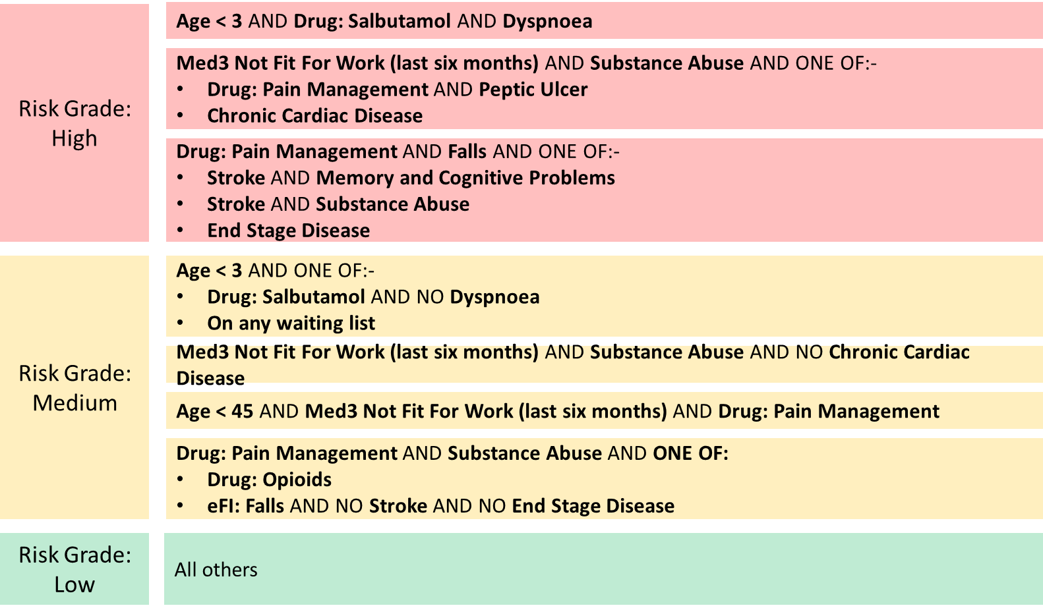
Using AI to predict the risk of A&E attendance
This figure shows a summary of the risk groups for attending A&E in the next 12 months. In the high-risk cohorts (1.8% of patients who are at highest risk of attending A&E) identified across the life course include:
  young children (less than 3 years old) who present with wheeze and breathlessness
  working age adults with complex issues such as substance misuse, mental health problems, and social issues
  older frail population with history of falls, stroke and memory/cognitive problems and end-stage disease
Opportunities to use this to identify ‘rising risk’ cohorts of patients for proactive multidisciplinary team case management to avoid A&E attendances and acute admissions.
Features of cohorts of patients in HWE categorised by risk of requiring A&E using artificial intelligence.
Credit: Rushabh Shah

Slide 19
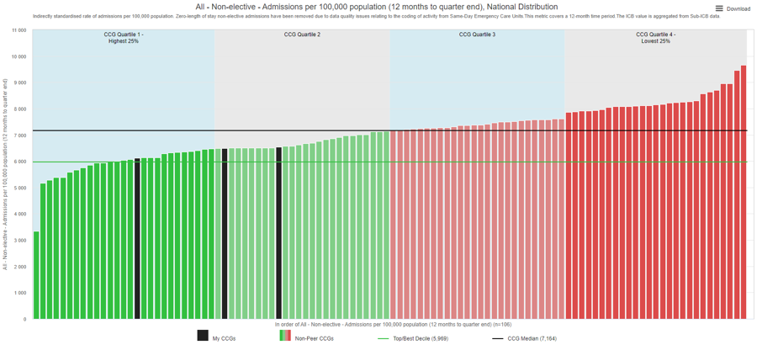
UEC activity in HWE: Emergency admissions per 100,000
Non-elective (emergency) admissions per 100,000 population Q3 2022 to Q3 2023, national distribution
The rate of non-elective (emergency) admissions in HWE is lower than the national median.
The lowest emergency admissions are seen in East & North Hertfordshire (quartile 1).
ENH
6,127
SWH
6,541
WE
6,491

Slide 20
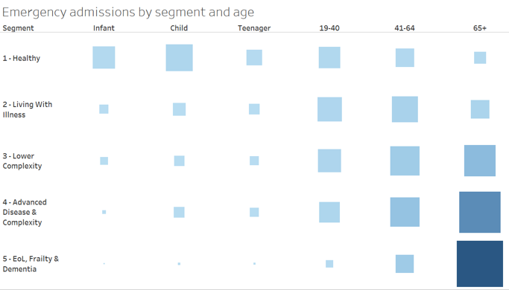
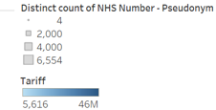
  Segmentation model: Emergency hospital admissions
The greatest volume and highest cost emergency admissions are among the older adults in the ‘End of Life, Frailty and Dementia’ segment.
Older people living with frailty are at risk of rapid decline, deconditioning, delirium, and loss of reserve with poorer outcomes when admitted as an emergency.
There is opportunity for greater proactive support and advanced care planning to reduce emergency admissions and ensure outcomes align to patient wishes. In addition, alternative pathways providing care closer to home (urgent community response, virtual wards) and admission avoidance through acute frailty services.

Slide 21
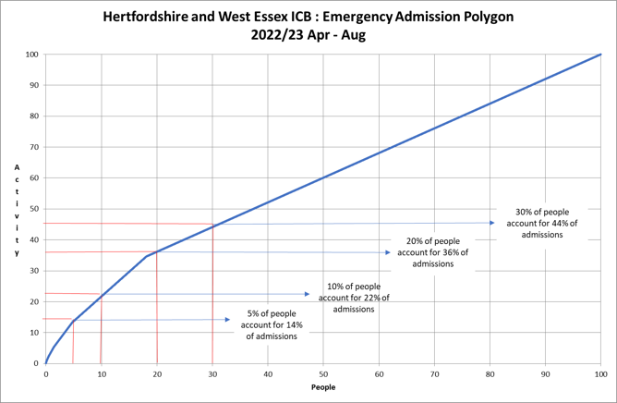
High intensity users
What are they being admitted for? 25% admissions are accounted for by the following primary diagnosis.
Of all emergency admissions across HWE between April to August 2022, 5% of people accounted for 14% of emergency admissions.
Most of these admissions are short (53% stayed two nights or less).
The primary reason for admission often related to acute ambulatory care sensitive conditions (ACSCs) e.g. urinary tract infection, pneumonia, and cellulitis which could be amenable to same day emergency care (SDEC) and chronic ACSCs e.g. chronic obstructive pulmonary disease, heart failure, and inflammatory bowel disease which may reflect a gap in effective case management and treatment escalation planning.

Slide 22
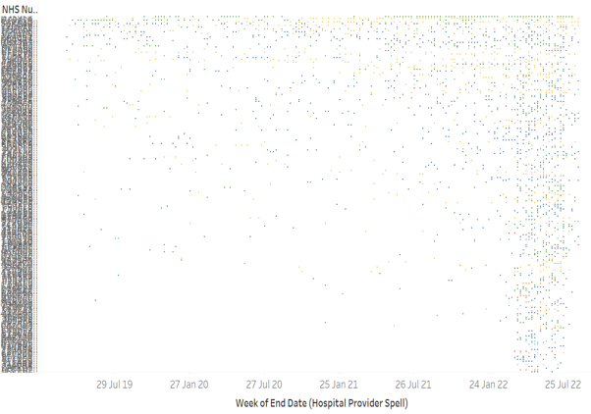

High intensity users (HIUs)
A small proportion of the population are at high risk of frequent attendance at A&E and emergency admissions.
National data identifies two cohorts aged 20-29 and 70+. Individuals often have a range of physical and mental health issues, but also face social issues (substance misuse, deprivation, housing instability, social isolation and loneliness). A sudden crisis e.g. relationship breakdown or loss can trigger frequent admissions.
In HWE, in ENH and WE patients with 4 or more emergency admissions (during period April - August 2022) were identified as HIUs. Data from the previous three years was reviewed for this cohort of 211 patients.
Each row on the graph represents one patient. Overlaying the segmentation model, can broadly see that those who have had sustained high intensity use over the last three years predominantly belong in Advanced Disease & Complexity (which includes social complexity) and End of Life, Frailty & Dementia segments, so similar to national profile of HIUs.
The other cohort are those who are only recently frequently admitted and whose prior use of emergency care was low, this latter group of individuals are likely to require a different intervention.

Slide 23
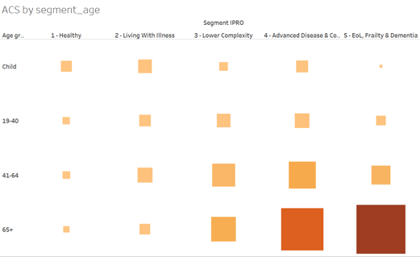
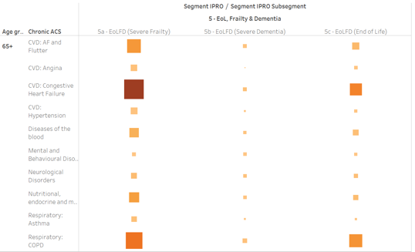

Emergency admissions - Ambulatory Care Sensitive Conditions (ACSCs)
ACSCs emergency admissions by segment and
all ages
ACSCs emergency admissions in EoL, Frailty & Dementia subsegment, adults aged 65+ years
Source: SUS
Between April 2021 and September 2022 there were 11,953 people admitted 15,563 times for chronic ambulatory care sensitive conditions. These should not normally require hospitalisation and cost £42 million (costed at tariff value).
The greatest volume and highest cost admissions for ambulatory care sensitive conditions (ACSCs) are amongst older adults in the advanced disease and complexity and end of life, frailty and dementia segments.
Most of these admissions were in older adults with severe frailty and at end of life. Particularly for congestive heart failure and COPD.

Slide 24
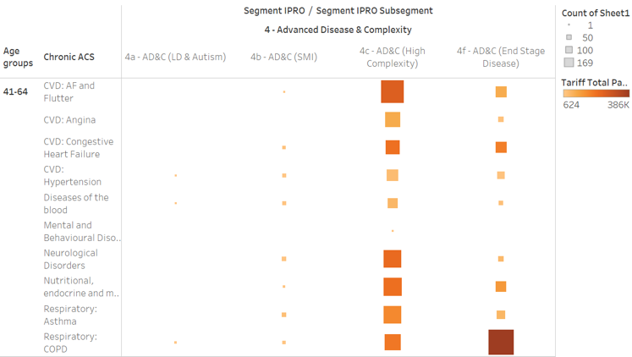
Emergency admissions ACSCs by segment and age
Amongst adults (41-64 years) in the advanced disease and complexity segment, the highest volume of ACSC admissions are those with end stage chronic obstructive pulmonary disease (COPD).
For those in high complexity subsegment, the highest volume of emergency admissions is for atrial fibrillation and atrial flutter.
There is an opportunity for improved case management of these conditions in the community and use of self-care management, treatment escalation plans and advanced care planning, and increased streaming to same day emergency care services (SDEC).

Slide 25
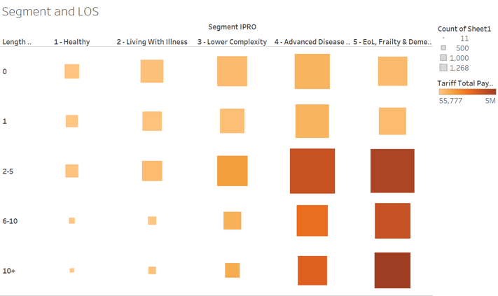
Emergency admissions ACSCs - length of stay (LOS)
Emergency admissions for ambulatory care sensitive conditions should be avoidable or amenable to same day emergency care (SDEC).
Particularly in the ‘advanced disease and complexity’, and ‘end of life, frailty and dementia’ segments, there are high volumes of admissions which have a length of stay 6-10 days or 10+ days.
This is of particular concern as longer length of stay is associated with deconditioning and decompensation.
There is an opportunity to shift care closer to home through increased utilisation of virtual wards and discharge to assess.
Source: SUS

Slide 26
Summary of UEC need across the life course
Children & young people
Adults
Older people

Slide 27
Children and Young People
Across HWE 1 in 4 children attend A&E
Largest volume of A&E attendances that resulted in no investigation or treatment amongst children in ‘healthy’ segment
Variation across HWE:
  A&E attendance amongst <1 year olds significantly higher in West Essex compared to national average
  Emergency admissions for children significantly higher in East & North Hertfordshire compared to national average
Children with difficulty breathing predicted as high risk for attendance at A&E
The vast majority (over three quarters) of A&E attendances in children are discharged home or back to their GP.

Slide 28
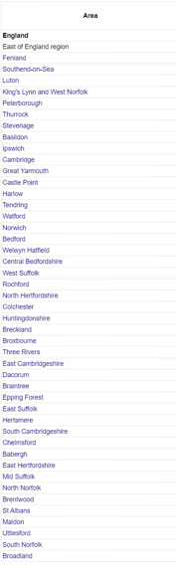
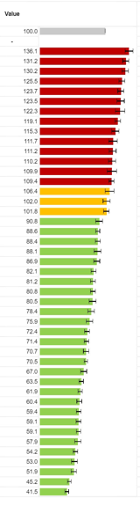
Adults
Emergency hospital admissions for Chronic Obstructive Pulmonary Disease (COPD), standardised admission ratio (2016/17 -2020/21)
Across HWE 1 in 5 adults attend A&E
Large volume of A&E attendances that resulted in no investigation or treatment in working age adults in ‘healthy’ segment
Variation across HWE:
  Emergency hospital admissions for coronary heart disease (CHD) and chronic obstructive pulmonary disease (COPD) is significantly higher than national average in certain districts e.g. Harlow, Watford and Stevenage
  Higher suicide rate in Harlow compared to national average
  Alcohol-related admissions higher in areas with
High intensity users are adults with multiple disadvantage (mental health, substance misuse, social complexity)
High cost emergency admissions for ACSCs in adults in ‘advanced disease and complexity’ segmentation, in particular AF/atrial flutter and end-stage COPD
Source: Office for Health Improvement and Disparities (OHID) Fingertips Public Health Profiles

Slide 29
Older people
Across HWE 1 in 4 older people attend A&E
High cost A&E attendances in those in advanced disease and complexity and particularly end of life, frailty and dementia population segments
High volume and high cost emergency hospital admissions in older people in the end-of-life, frailty, and dementia segment
Account for large proportion of high-cost (and prolonged duration of stay) emergency admissions for ACSCs, particularly high cost is emergency admissions for congestive heart failure in severe frailty patients
Variation across HWE (2021/22):
  A number of districts with significantly higher rate of emergency admissions due to falls in aged 65 and over compared to national average
  In SWH the rate of emergency admissions due to falls injuries in those aged 65 and over, higher than national CCG median (Source: Model hospital)
  HWE has a higher percentage of patients aged 85+ with an anticholinergic burden (ACB) of ≥6 when compared to the national median. Anticholinergic burden is the cumulative effect on an individual of taking one or more medications with anticholinergic activity. A score of ≥3 increases risk of cognitive and functional impairment, falls and mortality in older adults
Source: Fingertips 2021/22, secondary care data
Acknowledgement: Heidi Bowing, Clinical Fellow HWE ICB
In depth EoL and Frailty and falls data packs available on HWE PHM website

Slide 30
Triangulation
Local audit/deep dive
  Mental health clinical deep dive
  Missed opportunities audit
Current service provision
Service user perspectives (national)
Evidence review
Reduce ambulance conveyances
Reduce ED attendance
Reduce demand for UEC
Reduce emergency admissions to hospital
Safe & effective discharge

Slide 31
Mental health clinical deep dive
In October 2022, a clinical deep dive into the narrative behind admissions for mental health conditions via emergency department, ED in all three acute trusts was conducted. A sample of case notes from 11-17th October were reviewed. Ratio of male to female roughly equal and ages ranged from 18 to 91 years.
Themes identified
Alcohol and drug misuse contributed to more than half of presentations
Number of high intensity/frequency users who were already known to services
Patients often brought in by the police
Poor communication between hospital, community and mental health teams
Fragmentation of the system (lack of joined up services between psychiatry, drug and alcohol, social services and primary care)
ED was an inappropriate setting for many patients who would have been better signposted to primary or community care
Difficulties with discharge e.g. lack of available mental health beds
 | Lister | Watford | Princess Alexandra | Total
Adult presentations to ED coded as mental health in October 2022 | 202 | 255 | 174 | 631
Number admitted | 38 (19%) | 76 (30%) | 28 (16%) | 142 (23%)
Deep dive sample | 26 | 26 | 25 | 77
Source: Mental health in Emergency Departments deep dive reports, Dr Anna Benson (Mental health lead for HEW ICB) and Dr Jo Farrow (Consultant Psychiatrist), HWE 2022.
Recommendations
Mental health liaison service and MH training for ED staff (short-term)
ED community navigators and social prescribers and suicide training for GP and ED staff (medium-term)
Increase number of crisis cafes and alternatives to ED (long-term)
Case management for high intensity users, joint working MDT approach to support individuals and work with ED based navigators and alcohol workers.
Alcohol and drugs discharge pathway

Slide 32
Missed opportunities audits
Reduce ambulance conveyances
Reduce ED attendance
Reduce demand for UEC
Reduce emergency admissions to hospital
Safe & effective discharge
In 2022, a series of on-site audits were carried out at the three acute trusts by clinical transformation colleagues and integrated urgent emergency care (iUEC) team. Themes identified are shown below.
Very few patients had tried to contact primary care
Limited or no access to safe haven facilities for patients intoxicated with drug or alcohol so ambulance crews conveyed to A&E
Reduce emergency admissions to hospital
High proportion of patients are inappropriate attendees, most of these attended between 10am and midnight
For reasons such as ‘lack of access’ there was insufficient streaming to medical SDEC, GP/111, surgical SDEC
Insufficient streaming to urology, gynaecology, ENT, plastics
Ambulance have lack of access to primary care and lack of information on alternative to conveyance pathways
Notes:
In 2022 a series of on-site audits were carried out at the three acute trusts by clinical transformation colleagues and integrated urgent emergency care (iUEC) team.

Slide 33
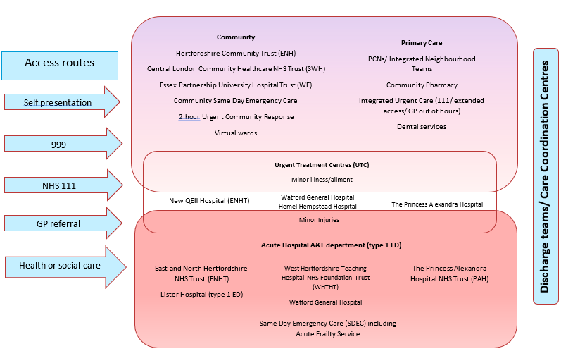
Overview of current service provision
The urgent and emergency care system is complex with a number of services delivered by different providers across HWE, this image captures some of these.
The subsequent slide maps some of these services geographically across HWE.

Slide 34
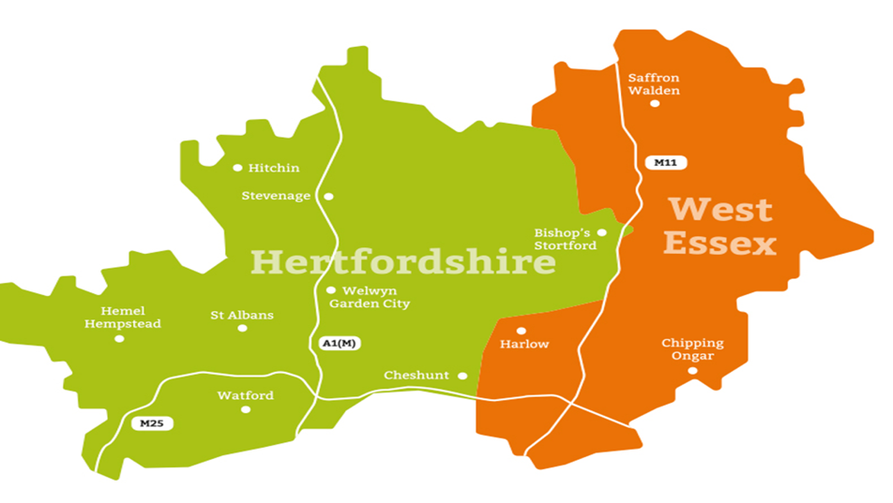
Overview of current service provision
Place: East & North Hertfordshire (ENH)
Acute: East & North Herts Trust (ENHT)
Lister Hospital – A&E no UTC
QEII - UTC
Hertford County
Community: Hertfordshire Community Trust (HCT)
MH: Hertfordshire Partnership Foundation Trust (HPFT)
ENHT – Lister Hospital
Hertford County
QEII
Hemel Hempstead Hospital
St Albans City
Watford General Hospital
Place: South & West Herts (nee Herts Valley)
Acute: West Herts Hospital Trust (WHHT)
Watford General – A&E & UTC
Hemel Hempstead Hospital - UTC
St Albans City Hospital
Community: Central London Community Healthcare (CLCH) NHS Trust
MH: Hertfordshire Partnership Foundation Trust (HPFT)
PAH
Place: West Essex
Acute: Princess Alexandra Hospital (PAH) A&E + UTC
Community: Essex Partnership University Hospital Trust (EPUT)
MH: EPUT, North East London NHS Foundation Trust (NELFT)

Slide 35
Service user perspectives
A qualitative study from the University of Sheffield (Ablard et al. 2020)
Method
Thirty (30) service users who had used a variety of UK urgent and emergency care services within the previous year including NHS111, ambulance service, GP Out of Hours (OOHs), Minor Injury Units (MIUs), walk-in centres or emergency department were stratified into groups: 18-45 years, >75 years, adults with young children, and adults with long-term conditions.
Results
Researchers found that service users wanted:
1) A simplified UEC system which is easier to understand and a single-point of access
  Clear and up to date info about services available to them locally
  Equal access within the system regardless of where they live
2) A more 'joined-up' UEC system
  Linked medical records so they receive continuity of care and do not have to repeat medical information
3) Better communication from health staff when accessing UEC services
  More information about what is happening to them and why
  Communication about waiting times was more important to service users than the wait times themselves
Ablard S., Kuczawski, M., Sampson FC., et al. (2020) What does the ideal urgent and emergency care system look like? A qualitative study of service user perspectives Emergency Medicine Journal 37 200-205

Slide 36
Evidence review
Reduce ambulance conveyances
Reduce ED attendance
Reduce demand for UEC
Reduce emergency admissions to hospital
Safe & effective discharge
Prevention and
proactive models of
care
Reduce avoidable admissions
Early supported, safe and effective discharge
Care closer to home
Rapid response
Self-care and self-management:
  Self-care for minor ailments and self-management of long-term conditions are effective at improving quality of life and reducing dependency on UEC services.
  For example, schemes to educate and support adults with asthma and COPD to self-manage have been shown to reduce emergency admissions to hospital
  A Department of Health study found that self management courses led to a 7% decrease in GP consultations and a 16% reduction in A&E attendances
  However, groups most in need of support for self-care and self-management (for example, people in lower socio-economic groups) are least likely to receive it or have the means to access it.
Community pharmacy – can play an important role in enabling self-care, particularly in patients with minor ailments and long term conditions (LTCs) – however there is little public awareness of the range of services provided by pharmacists
Exercise interventions improved falls outcomes in 38 of 52 analyses (73%), including reductions in rate of falls, number of people falling and number of falls resulting in injury, needing medical attention or admission to hospital (NICE).
Source: NHS England Transforming urgent and emergency care services in England. Urgent and Emergency Care Review. End of Phase 1 Report. Appendix 1 – Revised Evidence Base from the Urgent and Emergency Care Review. 2013

Slide 37
Evidence review
Reduce ambulance conveyances
Reduce ED attendance
Reduce demand for UEC
Reduce emergency admissions to hospital
Safe & effective discharge
Patients should only be conveyed to ED if this is clinically appropriate for the patient’s needs, or where no alternative exists for safe ongoing treatment and care.
999: Qualitative study of patients who used ‘999’ services for primary care needs: many people used ambulance services because they were not aware of or were confused by alternative offerings.
End of life (EoL) care – uncertainty in the EoL care pathway (where they are absent or poorly scripted) often results in A&E attendances or emergency admissions that are, in retrospect, deemed to be unnecessary.
Community-based palliative care could reduce ED visits in people with dementia. In one study in Western Australia 2009-2011, in their last year of life, people with dementia who were not receiving community-based palliative care visited EDs up to six times more frequently than people with dementia who were receiving community-based palliative care.
Reducing admissions from care homes – implementation of the Care Home Innovation Programme (CHIP) which involved; employing a MDT (including community matron for reactive care and care planning,) a televideo system (providing 24-h access to a band 7 nurse who could provide video assessment,) and replacing all previous incident protocols with new ones (13 clinically derived protocols that follow expert guidance on the initial management of common presentation e.g. falls, head injury, shortness of breath etc,) and training up care home staff to employ the new system. 32 care homes in Merseyside involved from 2015-2018. In comparison to the 12 months prior to launch, over a four-year period, implementation of the CHIP resulted in a 15% reduction of emergency calls, and in a 19% reduction of conveyances to hospital.
Falls framework - categorising falls into levels including level 1 (non-injury) falls with non-clinician response. Level 2 falls warranted paramedic and physiotherapist response. Level 3 falls had an emergency response. 50.8% of all non-FRS (falls response service) responses were transferred to ED, compared with just 10.6% of the patients responded to by the FRS team.
Source: NHS England Transforming urgent and emergency care services in England. Urgent and Emergency Care Review. End of Phase 1 Report. Appendix 1 – Revised Evidence Base from the Urgent and Emergency Care Review. 2013

Slide 38



Evidence review
Reduce ambulance conveyances
Reduce ED attendance
Reduce demand for UEC
Reduce emergency admissions to hospital
Safe & effective discharge
Transformational workstreams across HWE to tackle pressures in urgent and emergency care are varied. A successful scheme to reduce ambulance conveyances is the #handover@home. This involved a single point of access number for care coordination that ambulance crews could call before conveying patients to ED to find alternative pathways or care facilities.
A proof of concept conducted 5th to 12th October 2022 in East & North Hertfordshire found two thirds (66%) of contacts (i.e. clinical conversations) resulted in the patients not being conveyed to hospital.
The majority of those who were not conveyed went to Hospital @ Home or Early Intervention Vehicle (EIV). Other services used included primary care, ambulance ‘see & treat’, and other community services.
Credit: entire team working on #handover@home

Slide 39
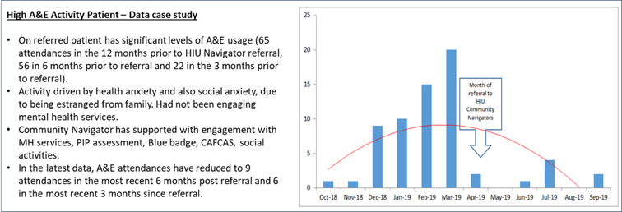
Evidence review
Reduce ambulance conveyances
Reduce ED attendance
Reduce demand for UEC
Reduce emergency admissions to hospital
Safe & effective discharge
Successful work in Herts Valleys: the High Intensity User (HIU) Community Navigator project
  85 HIUs received support between Apr 19 to Oct 19.
  Saw a reduction of 44% in A&E activity compared to activity prior to referral
  Social prescribing approach and other support coordinated
  April 2019 – March 2020 (was funded for a further year, however had to be cut due to Covid-19 pandemic)
Examples of underlying issues:
Anxiety
Depression
Loneliness
Examples of solutions:
Issue with garden solved with voluntary/community services
Bus pass issues resolved with council
Adult Care Services for aids and equipment
Grant to buy a new piece of furniture
Voluntary service to help declutter home
Acknowledgement: Paul O'Hare, Programme Manager Urgent Care, HWE ICB

Slide 40
Evidence review
Reduce ambulance conveyances
Reduce ED attendance
Reduce demand for UEC
Reduce emergency admissions to hospital
Safe & effective discharge
Hospital at Home/ Virtual Wards models can relieve system pressure through admission avoidance or early supported discharge. The terminology is used inconsistently but a recent rapid evidence synthesis (Norman et al., 2023) refers to British Geriatric Society report that describes a continuum of care provision in conjunction with remote monitoring, there is considerable overlap between virtual wards and hospital at home, and this overlap is greatest when care needs are highest and thus the vast majority of care is face-to-face. This rapid evidence synthesis included systematic reviews relating to virtual wards, hospital at home and remote monitoring. Findings: moderate certainty evidence that hospital at home results in reduced mortality compared to inpatient care for step-up models and similar mortality outcomes to inpatient stay for step-down models. Length of stay was reduced in step-down models but evidence on readmissions was low certainty. There were methodological issues in cost-effectiveness evidence. The evidence base for clinical effectiveness of hospital at home is more developed than for virtual wards as the service model has been in use for longer. It is recommended that for virtual wards sharing many features with hospital at home evaluation should prioritise cost-effectiveness, barriers to implementation and patient/carer experiences.
Consultant-delivered care evidence suggests that consultant-delivered care in A&E departments improves outcomes for some patient groups. It can also contribute to cost savings and increased service efficiency.
  The senior review of patients has a positive impact on patient outcomes. A study undertaken to assess the influence and effect of ‘real-time’ senior clinician supervision on patient disposition in a UK A&E department found that senior review of 556 patients reduced inpatient admissions (by 11.9 per cent) and reduced admissions to the acute medical unit specifically (by 21.2 per cent).
Norman et al. (2023) Virtual wards: a rapid evidence synthesis and implications for the care of older people Age Ageing 52(1): 10.1093/ageing/afac319

Slide 41
Summary and recommendations
Issue | Recommendation
One third of A&E attendances resulted in no investigation or treatment. Healthy young children account for the largest volume of these, healthy young adults the second largest. Very few patients had tried to contact primary care before attending A&E | Education via schools, community groups and use of platform Healthier Together Work with health visiting teams to support families with young children Development of Community Pharmacy Services, support implementation of Pharmacy First programme enabling pharmacies to supply prescription only medicines to treat seven common health conditions Improved access for urgent same day health needs, including accessible GP in- and out-of-hours, minor illness hubs, 111, 111 online, minor illness hubs, dental care, urgent treatment centres
A small proportion of the population are high intensity users (HIUs) with frequent emergency admissions Predictive modelling identified patients at highest risk of attending A&E in the next 12 months include: a) young children (less than 3 years old) who present with wheeze and breathlessness b) working age adults with complex issues such as substance misuse, mental health problems, and social issues c) older frail population with history of falls, stroke and memory/cognitive problems and end-stage disease | To further characterise these high intensity users and identify ‘rising risk’ cohorts of patients for proactive interventions to avoid repeated A&E attendances and acute admission Adopt different approaches for each high risk group: a) use of respiratory hubs and potentially virtual wards b) consider ED community navigators and social prescribers to support individuals and families, crisis management plans for mental health and work collaboratively with partners across the system to address wider determinants of health faced by HIUs c) Case management by integrated neighbourhood teams (INTs)
Adults with mental health, substance misuse and social complexity predicted high risk of A&E attendance in the next year Alcohol and drug misuse contributed to more than half of mental health presentations at A&E (56%) Limited or no access to safe haven facilities for patients intoxicated with drug or alcohol | Mental health liaison service meeting ‘core 24’ standard Prompt and reliable crisis advice for professionals, service users and carers Mental health and suicide training for primary care and ED staff More crisis cafes and sanctuaries Mental health practitioner within unscheduled care hub to support alternatives to conveyance for C3-5 calls

Slide 42
Summary and recommendations continued
Issue | Recommendation
Frequent emergency admissions in people in the End of life (EoL), frailty, and dementia segment | Increase identification of people at EoL to put them on the End of Life and Palliative Care register and ensure care plans are in place. Encourage and monitor use of MDT/Gold Standard Framework meetings for EoL patients and complex patients with severe dementia/frailty Develop pathways for alternatives to conveyance (for ambulance crew),and alternatives to admission (for ED staff)
Variation across HWE with significantly higher (compared to national average) rate of emergency admissions due to falls in those aged 65 in a number of districts Higher proportion of patients aged 85+ with an anticholinergic burden (ACB) of ≥6 in HWE compared to the national median | Increased identification of patients at risk of falls Increase self-referrals into falls prevention services and fracture liaison Implementation of falls pathways: long lie and falls with head injury when on anticoagulants Enhanced used of Early intervention vehicle (EIV) and Urgent Community Response (UCR) supported by clinical pathways System wide approach to addressing anticholinergic burden
Highest volume and highest cost emergency admissions for ambulatory care sensitive conditions (ACSCs) are amongst those in end of life, frailty and dementia (EoLFD) (highest in severe frailty) and the advanced disease and complexity (AD&C) segments. Particularly for congestive heart failure and COPD with prolonged length of stay for these admissions. | Proactive management of long-term conditions e.g. enhanced annual reviews, self-management programmes, medication reviews, treatment escalation plans, increased detection of COPD and heart failure patients at end of life with implementation of end of life care plans Greater utilisation of urgent community response (UCR) and step-up and step-down virtual wards Expansion of SDEC and Acute Frailty Service (avoid admission) Secondary management of frailty crises on discharge
Top 5% of patients with most frequent emergency admissions were admitted often for ACSCs and short LOS (≤2 days) | Review provision of SDEC and opening hours Expand SDEC pathways and greater streaming Closer working with prevention of admission community services

Slide 43
Opportunities identified by the population need analysis
Prevention and
proactive models of
care
Reduce avoidable admissions
Early supported, safe and effective discharge
Care closer to home
Rapid response
Healthy | Self-care using Healthier Together Health visitors and early years support preventative education and proactive care Public mental health initiatives | NHS 111 and online Embed multidisciplinary Clinical Assessment Service (CAS) within integrated NHS 111 (including paediatric) NHS Directory of Services | Accessible same day primary care Take ‘Pharmacy First’ approach, integrate and raise awareness of community pharmacy consultation service (CPCS) Acute respiratory hubs Reduce geographical (& opening hours) variation in access to UTCs | Paediatric Liaison Team
Living will illness Lower Complexity | Primary & secondary prevention of long-term conditions Improved disease detection & staging Improve ability to self-mange Personalised care plans allow direct referral to specialist | Single point of access 24/7 to mental health support via NHS 111 Same day access including self-referral to IAPT Unscheduled Care Hub (clinical assessment of C3-5 calls) Mental health ambulance response | Crisis cafes, sanctuaries, safe havens Mental health liaison service meeting ‘core 24’ standard Enhance Same Day Emergency Care (SDEC) hours, virtual ward (community detox pathway) | Social prescribing and community navigators High Intensity User programme
Expansion of virtual ward (step-down)
Low needs discharge support via VCSE
Single point of access to care coordination centres
Advanced
disease &
complexity
End of life,
frailty and
dementia
‘Healthy ageing’
Identification of frailty
Falls prevention (self-referral, fracture liaison services), medication reviews
Case management and coordination by Integrated Neighbourhood Teams
Advanced care plans (RESPECT documentation)
Call before convey (CB4C) for ambulance crews, #handover@home
Explore C2 segmentation
Early Intervention Vehicle (EIV)/Falls Car for level 1 and level 2 falls
Increase urgent community response (UCR) and Same Day Emergency Care (SDEC)
Expand virtual wards
Falls on anticoagulants pathway in care settings
Long lie pathway
Extended hours provision of Acute Frailty Service
Virtual ward
Early supported discharge – Discharge to assess (D2A)
Virtual ward (early supported discharge)
Expansion of reablement service
End of life discharge facilitator post

